Slide 1

Multivariable Optimization: Lagrange Multipliers
MTH 564 – Mathematical Modeling

Slide 2
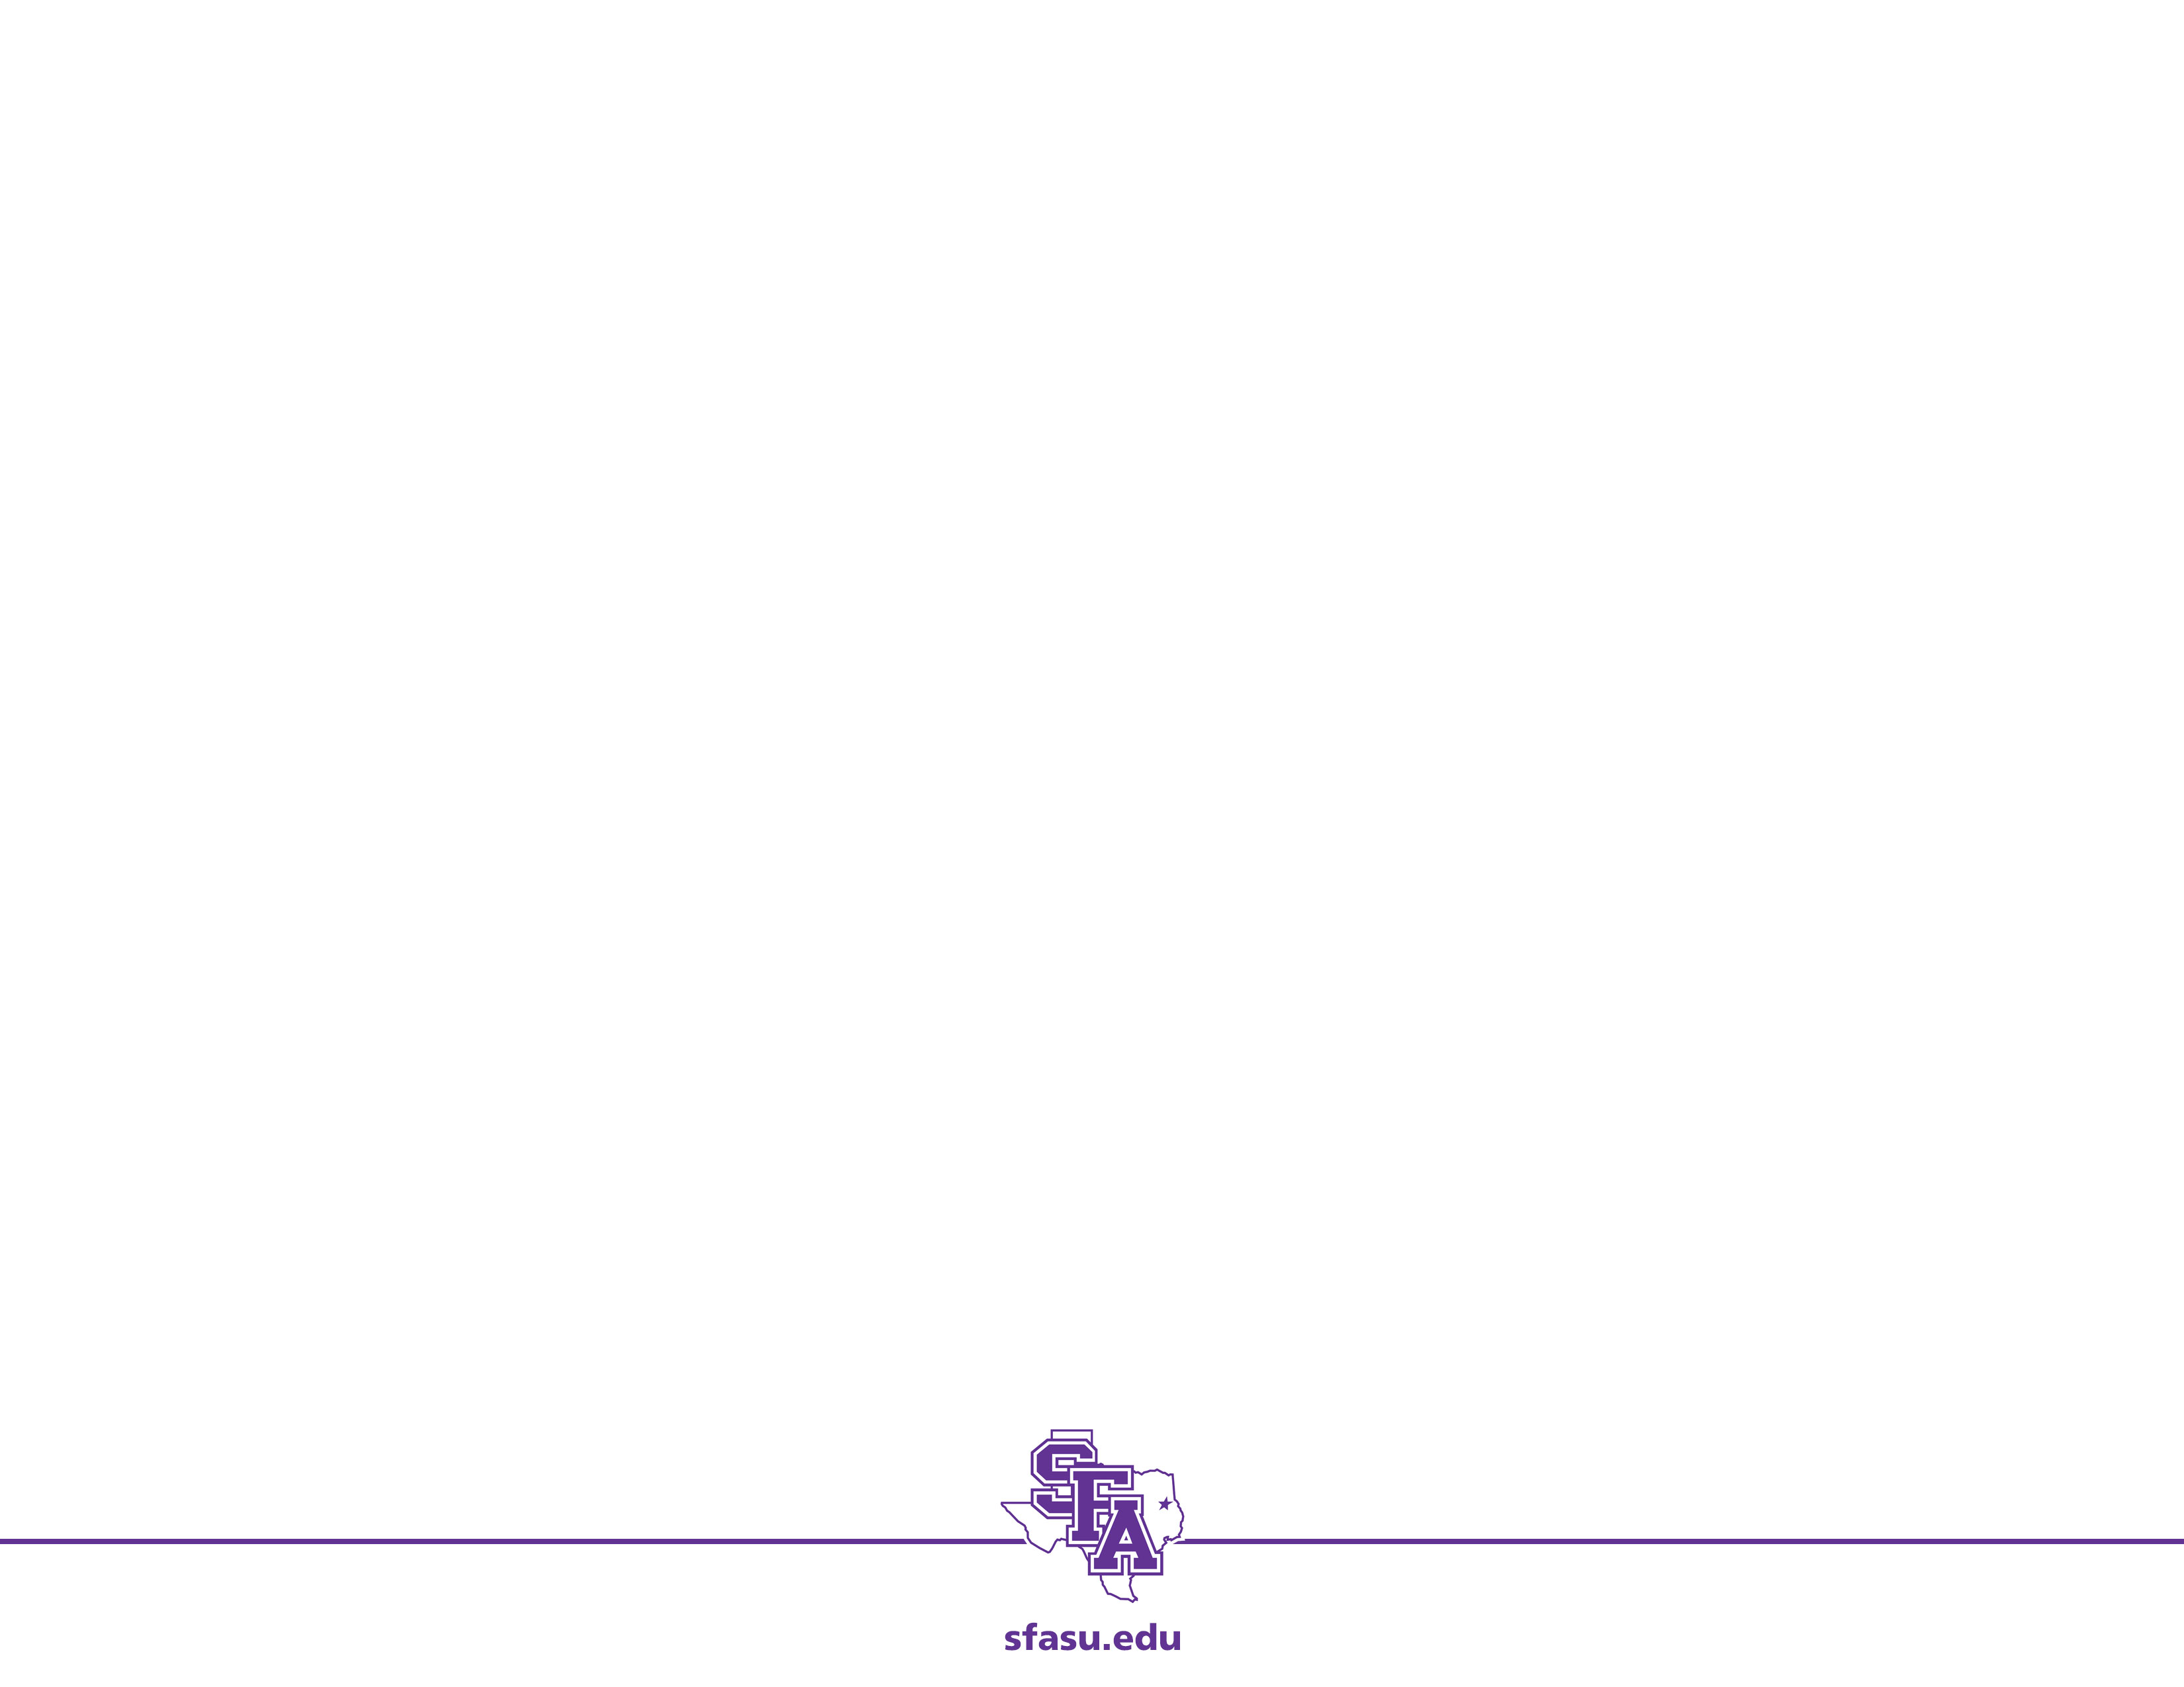
Original Example: TV Manufacturing
A manufacturer of color TV sets is planning the introduction of two new products, a 19-inch LCD flat panel set with a MRSP of $339 and a 21-inch LCD flat panel set with an MRSP of $399. The cost to the company is $195 per 19-inch set and $225 per 21-inch set, plus an additional fixed costs of $400,000. In the competitive market in which these sets are sold, the number of sales per year will affect the average selling price. It is estimated that for each type of set, the average selling price drops by one cent for each additional unit sold. Furthermore, sales of the 19-inch set will affect sales of the 21-inch set, and vice-versa. It is estimated that the average selling price for the 19-inch set will be reduced by an additional $0.003 for each 21-inch set sold, and the price for the 21-inch set will decrease by $0.004 for each 19-inch set sold. How many units of each type should be manufactured?

Slide 3
Constraints on Production
Previously we assumed the company could produce any number of TV sets per year. We now introduce constraints based on the available production capacity.
Additions to Example:
It is estimated that the available production capacity will be able to product 10,000 TV sets per year (about 200 per week). The company has an ample supply of 19-inch and 21-inch LCD panels and other standard components, however the circuit boards necessary for constructing the sets are in short supply. The supplier is able to provide 8000 boards per year for the 21-inch set and 5000 boards for the 19-inch model. How does this information change the product levels?

Slide 4
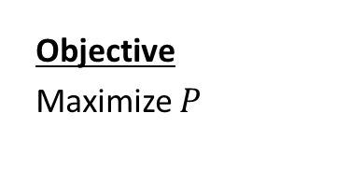
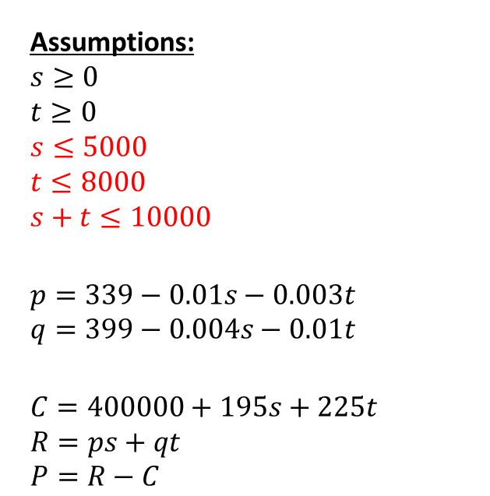
Step 1: New Assumptions
Variables:
s – # of 19-inch sets sold (per year)
t – # of 21-inch sets sold (per year)
p – selling price for 19 inch set ($)
q – selling price for 21 inch set ($)
C – cost of manufacturing TVs ($/yr)
R – revenue from the sale of TVs ($/yr)
P – profit from the sale of TVs ($/yr)
Assumptions:
$$s≥0$$
$$t≥0$$
$$s≤5000$$
$$t≤8000$$
$$s+t≤10000$$
$$p=339−0.01s−0.003t$$
$$q=399−0.004s−0.01t$$
$$C=400000+195s+225t \\ R=ps+qt \\ P=R−C$$
Objective
Maximize $P$
Parameters:
$0.01 – amount of price drop per unit sold
$0.003 – amount of price drop for 19-inch set for each 21-inch sold
$0.004 – amount of price drop for 21-inch set for each 19-inch sold

Slide 5
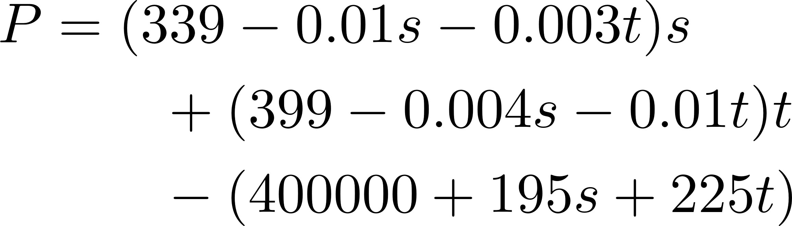

Step 2: Select the modeling approach
Assumptions:
$$s≥0$$
$$t≥0$$
$$s≤5000$$
$$t≤8000$$
$$s+t≤10000$$
$$p=339−0.01s−0.003t$$
$$q=399−0.004s−0.01t$$
$$C=400000+195s+225t \\ R=ps+qt \\ P=R−C$$
Recall:
The profit function can be expressed in terms of just the independent variables s and t. Therefore, this is a multivariable constrained optimization problem.

Slide 6
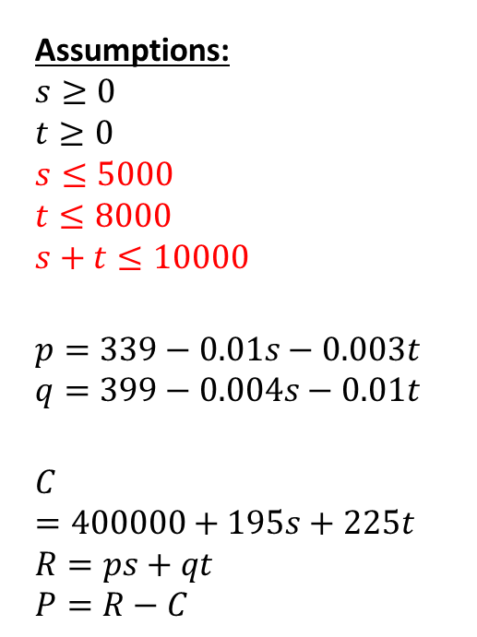
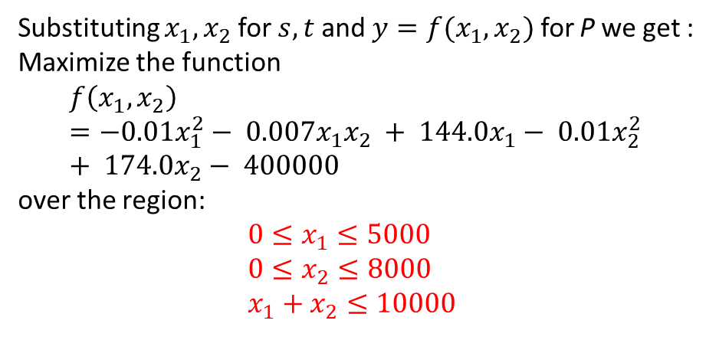
Step 3: Formulate the model
Assumptions:
$$s≥0$$
$$t≥0$$
$$s≤5000$$
$$t≤8000$$
$$s+t≤10000$$
$$p=339−0.01s−0.003t$$
$$q=399−0.004s−0.01t$$
$$C=400000+195s+225t \\ R=ps+qt \\ P=R−C$$
Maximize:
Substituting $x_{1},x_{2}$ for $s,t$ and ${y=f(x}_{1},x_{2})$ for P we get : Maximize the function
$$f\left(x_{1},x_{2}\right)=−0.01x_{1}^{2}− 0.007x_{1}x_{2} + 144.0x_{1}− 0.01x_{2}^{2} + 174.0x_{2}− 400000$$
over the region:
$0≤x_{1}≤5000$
$0≤x_{2}≤8000$
$x_{1}+x_{2}≤10000$

Slide 7
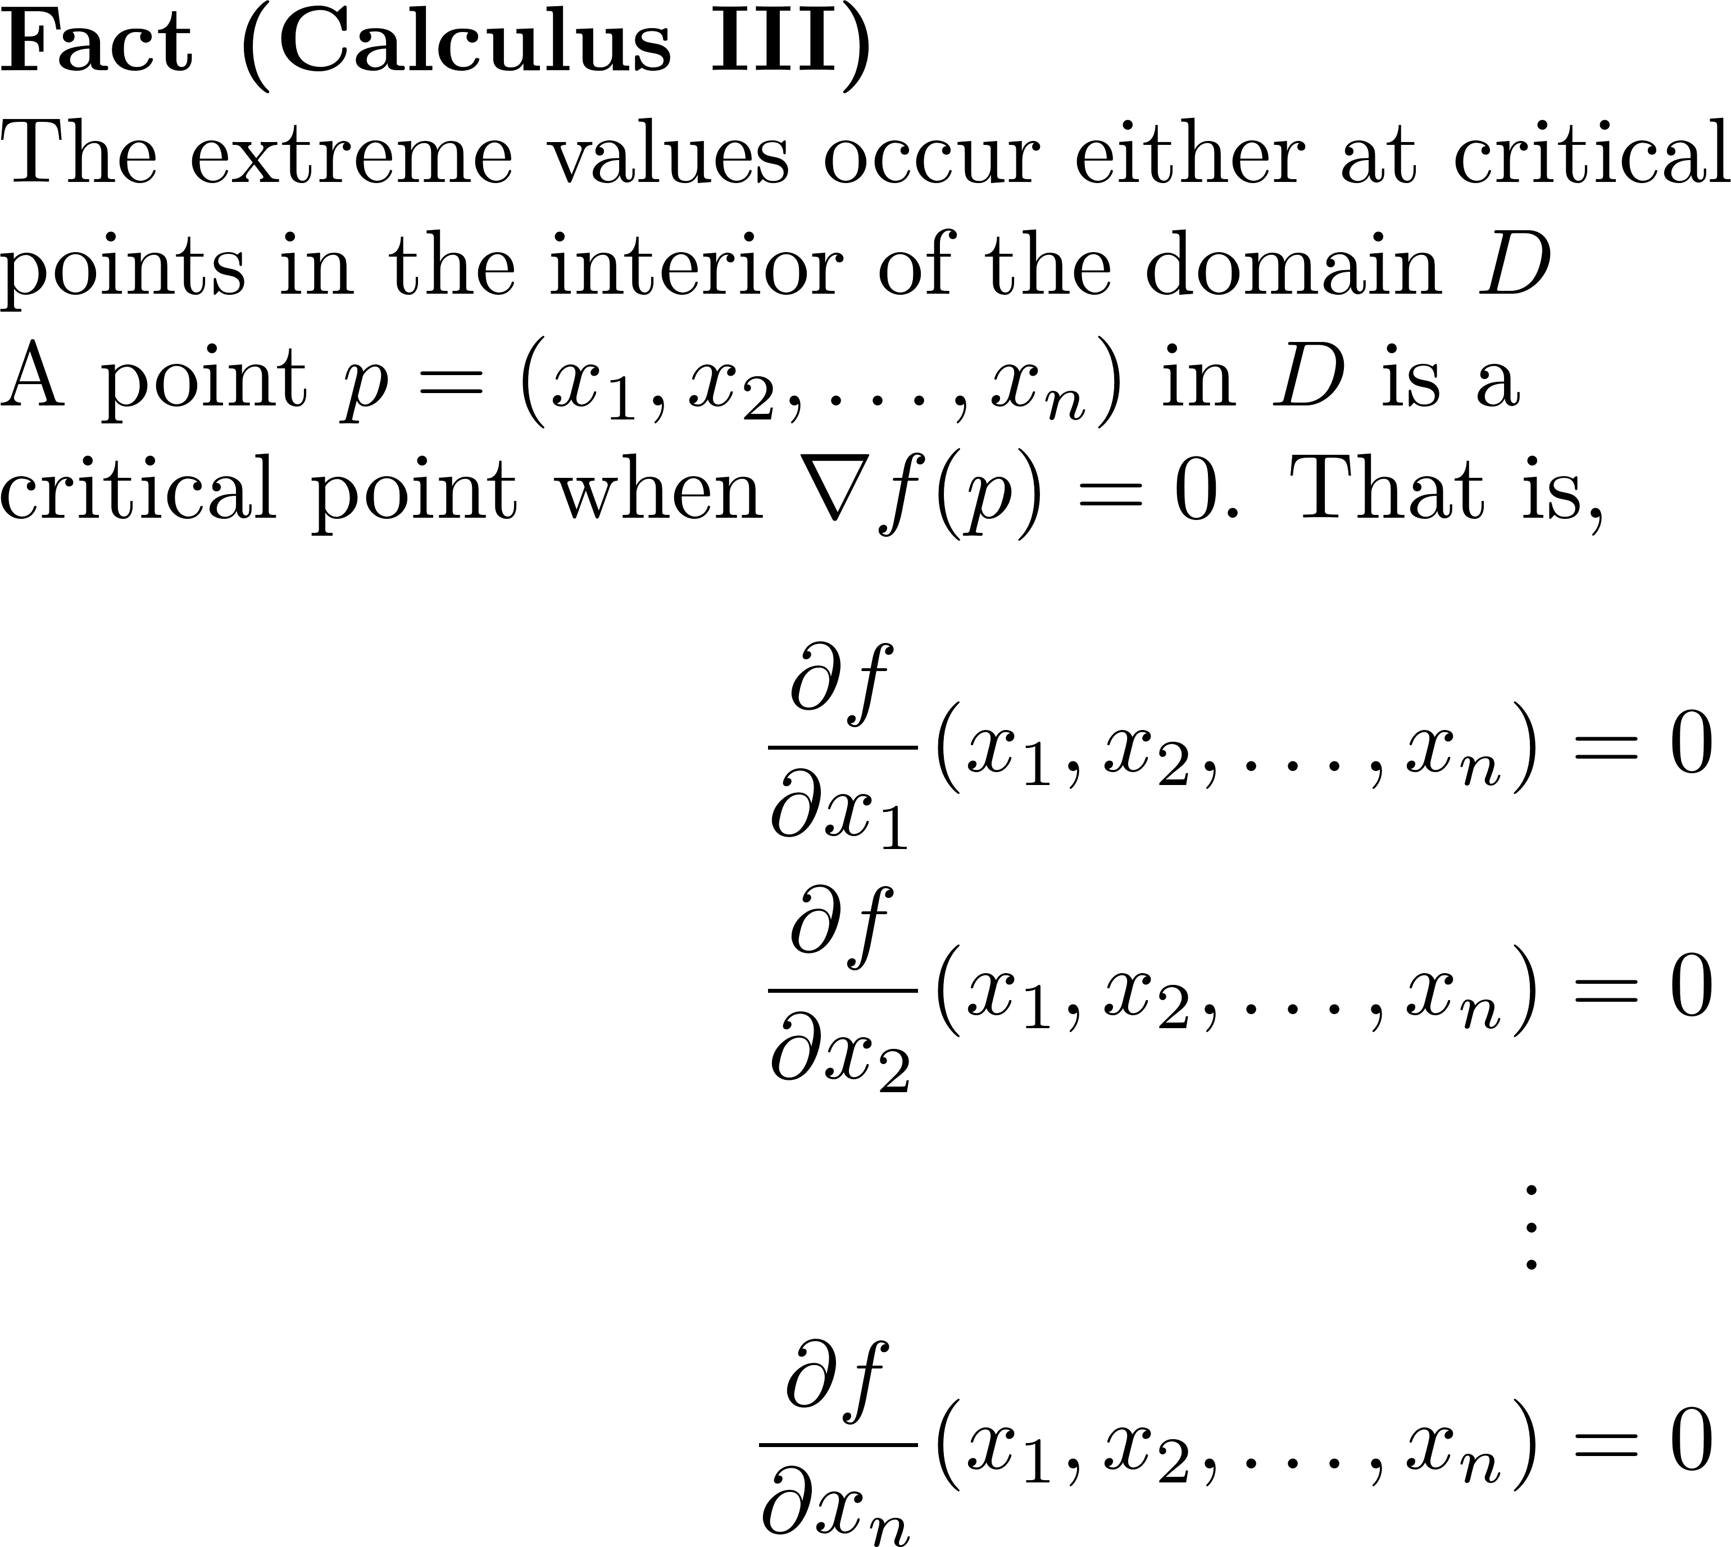
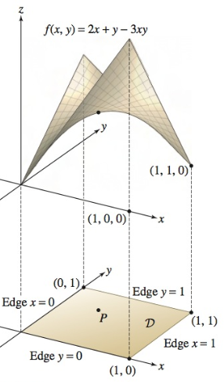
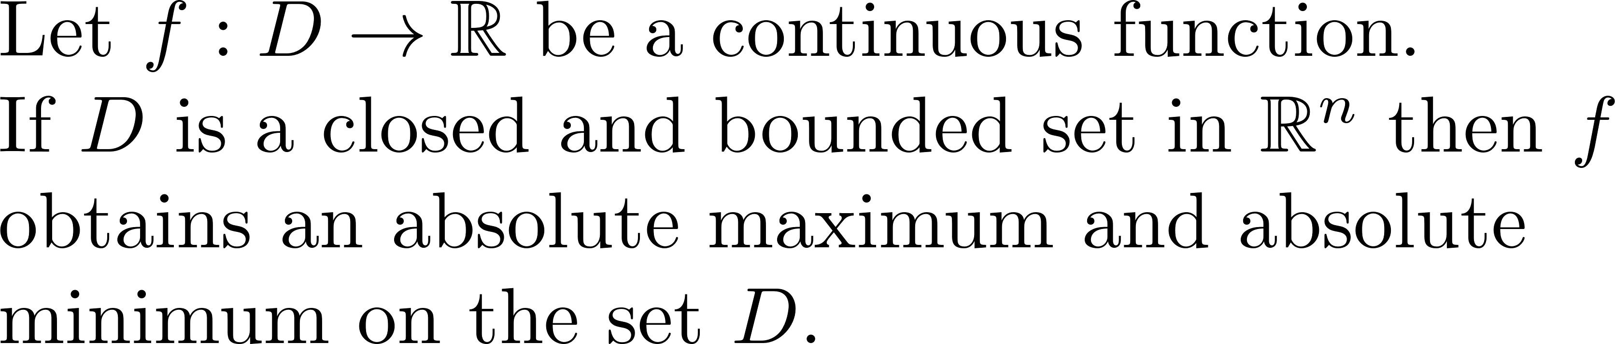
Extreme Value Theorem (Calculus III)
Extreme Value Theorem (EVT)

Slide 8
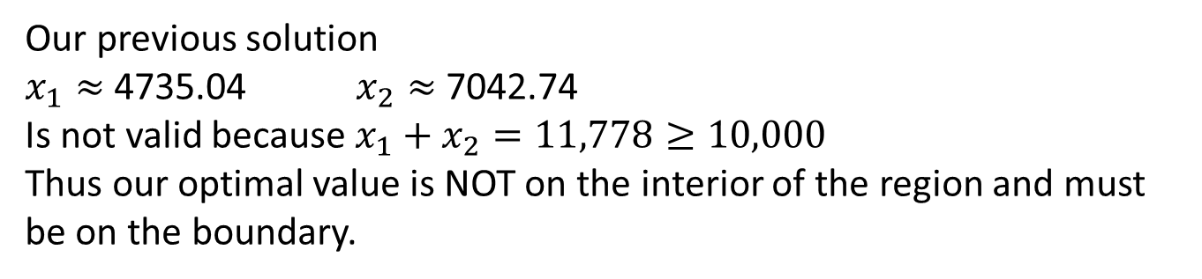
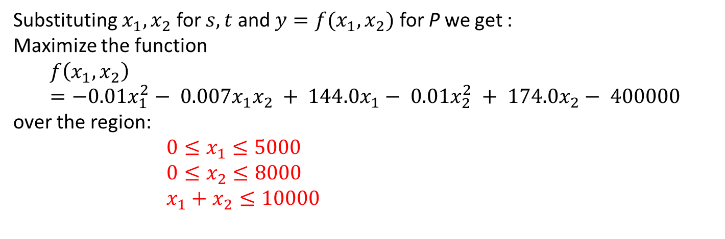
Step 4: Check Previous Solution
Substituting $x_{1},x_{2}$ for $s,t$ and ${y=f(x}_{1},x_{2})$ for P we get : Maximize the function
$$f\left(x_{1},x_{2}\right)=−0.01x_{1}^{2}− 0.007x_{1}x_{2} + 144.0x_{1}− 0.01x_{2}^{2} + 174.0x_{2}− 400000$$
over the region:
$0≤x_{1}≤5000$
$0≤x_{2}≤8000$
$x_{1}+x_{2}≤10000$
Our previous solution
$x_{1}≈$4735.04 $x_{2}≈$7042.74
Is not valid because ${x_{1}+x}_{2}=11,778≥10,000$
Thus our optimal value is NOT on the interior of the region and must be on the boundary.

Slide 9
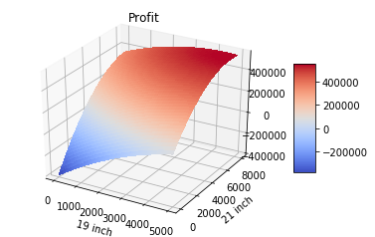
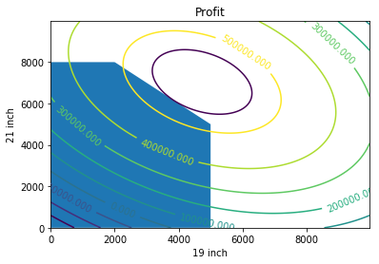
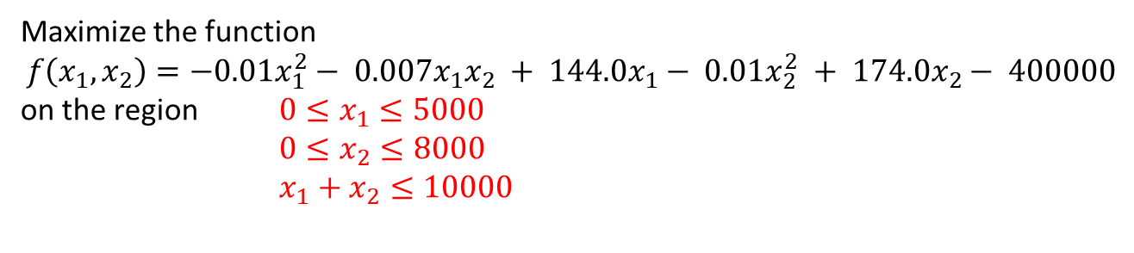
Step 4: Solve the Problem
Maximize the function
$$f\left(x_{1},x_{2}\right)=−0.01x_{1}^{2}− 0.007x_{1}x_{2} + 144.0x_{1}− 0.01x_{2}^{2} + 174.0x_{2}− 400000$$
on the region $0≤x_{1}≤5000$
$0≤x_{2}≤8000$
$x_{1}+x_{2}≤10000$
feasible region – set of all possible solutions
Notes:
Based on the picture it appears the maximum is at the intersection of the purple contour and the region.
See python file section1-1pig.py

Slide 10
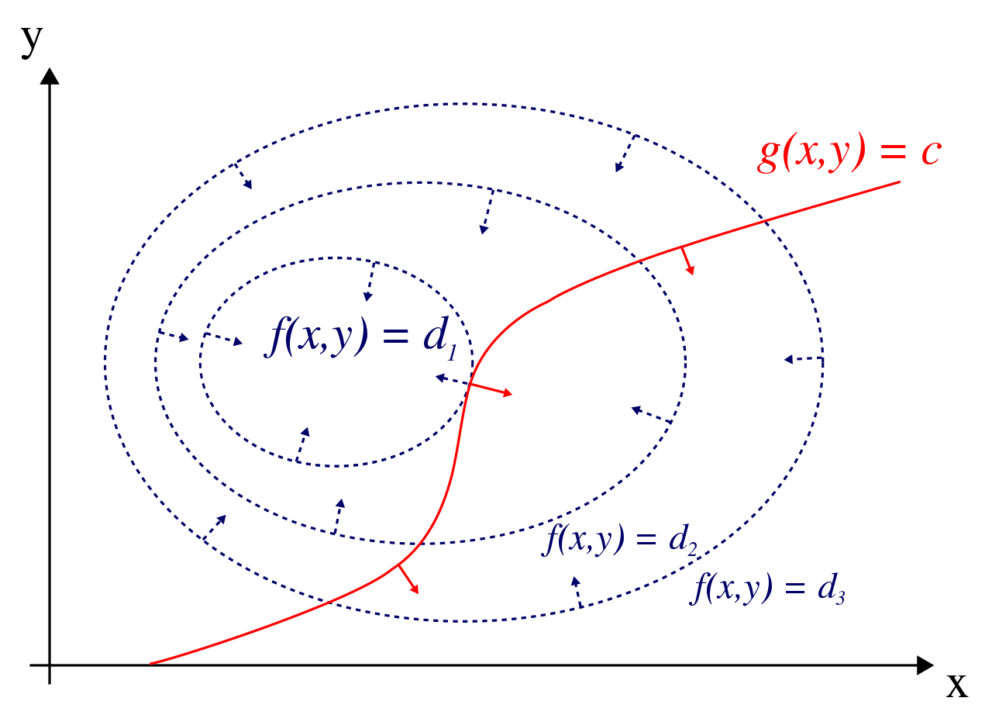
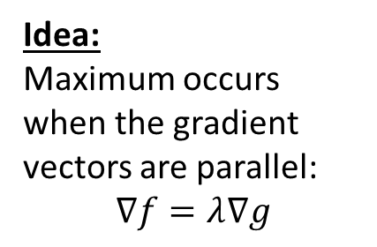
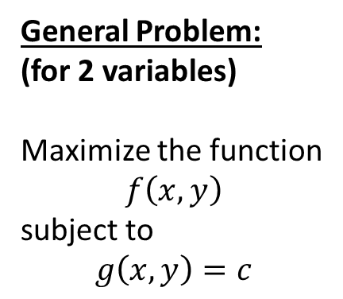
Lagrange Multipliers
General Problem:
(for 2 variables)
Maximize the function
$$f\left(x,y\right)$$
subject to
$$g\left(x,y\right)=c$$
Idea:
Maximum occurs when the gradient vectors are parallel:
$$∇f=λ∇g$$
Notes:
This is the 2 variable version. Notice the vectors are the gradients of the respective curves.

Slide 11
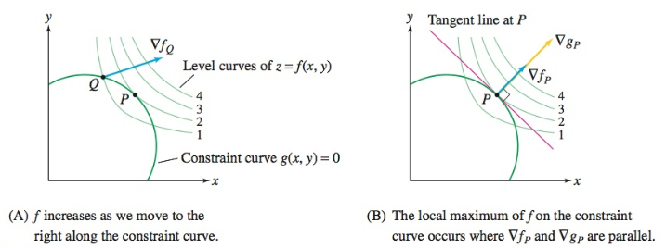
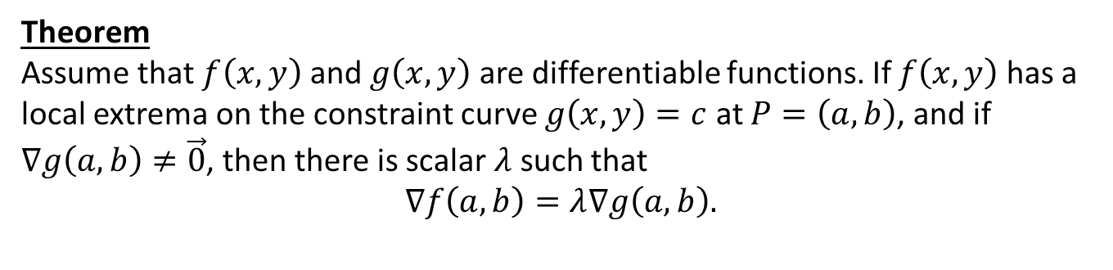
Lagrange Multipliers (2-variable)
Theorem
Assume that $f\left(x,y\right)$ and $g\left(x,y\right)$ are differentiable functions. If $f\left(x,y\right)$ has a local extrema on the constraint curve $g\left(x,y\right)=c$ at $P=\left(a,b\right)$, and if $∇g\left(a,b\right)≠\vec{0}$, then there is scalar $λ$ such that
$$∇f\left(a,b\right)=λ∇g\left(a,b\right).$$
Notes:
This is the 2 variable version. Notice the vectors are the gradients of the respective curves.
\lambda is called a Lagrange multiplier

Slide 12
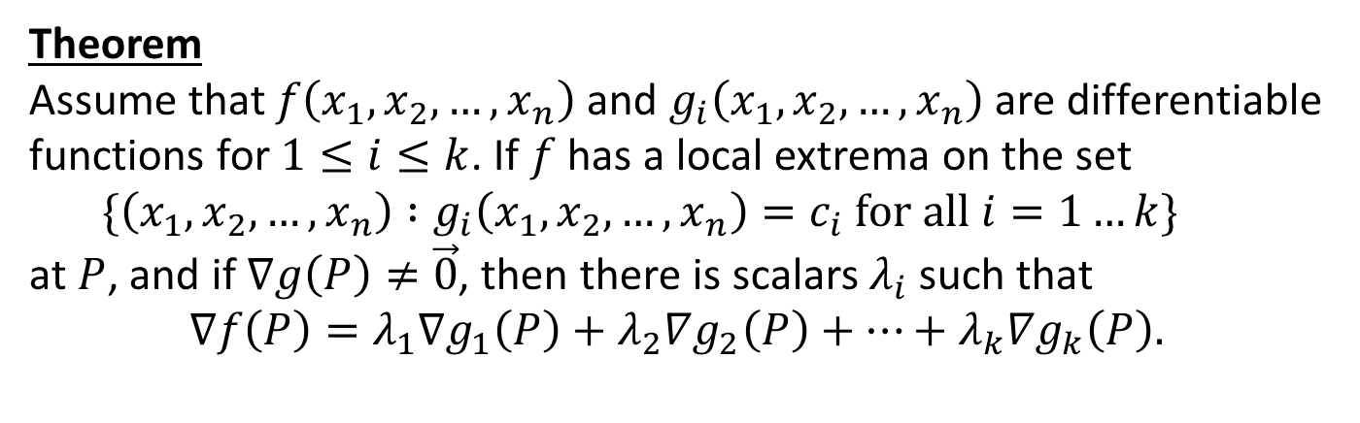
Lagrange Multipliers (n-variable)
Theorem
Assume that $f\left(x_{1},x_{2}, …,x_{n}\right)$ and $g_{i}\left(x_{1},x_{2}, …,x_{n}\right)$ are differentiable functions for $1≤i≤k$. If $f$ has a local extrema on the set
$\{{\left(x_{1},x_{2}, …,x_{n}\right) :g}_{i}\left(x_{1},x_{2}, …,x_{n}\right)=c_{i} for all i=1…k\}$
at $P$, and if $∇g\left(P\right)≠\vec{0}$, then there is scalars $λ_{i}$ such that
$$∇f\left(P\right)=λ_{1}∇g_{1}\left(P\right)+λ_{2}∇g_{2}\left(P\right)+⋯+λ_{k}∇g_{k}\left(P\right).$$
Notes:
This is the 2 variable version. Notice the vectors are the gradients of the respective curves.

Slide 13
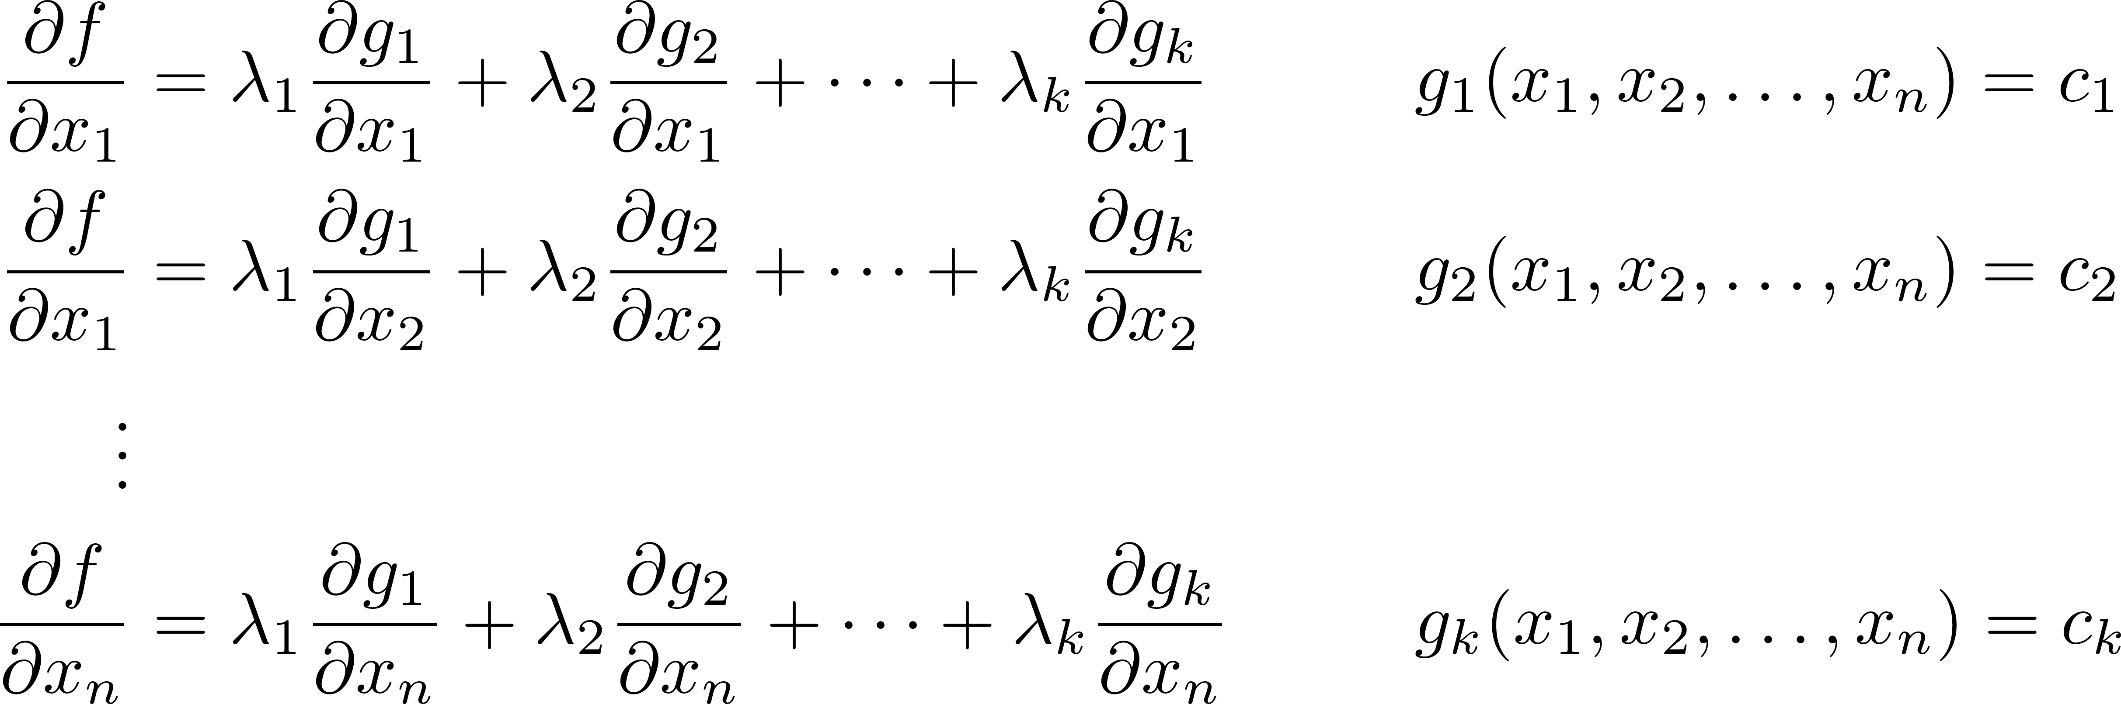
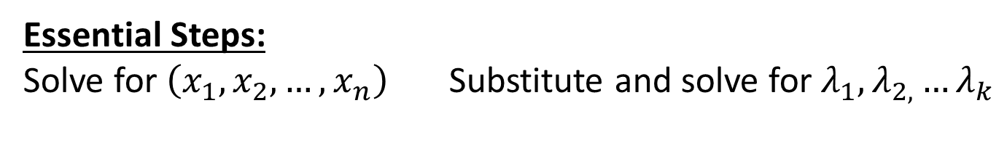
Lagrange Multipliers (n-variable)
Essential Steps:
Solve for $\left(x_{1},x_{2}, …,x_{n}\right)$ Substitute and solve for $λ_{1},λ_{2,}…λ_{k}$
Notes:
Here are the two (can be somewhat) difficult steps.

Slide 14
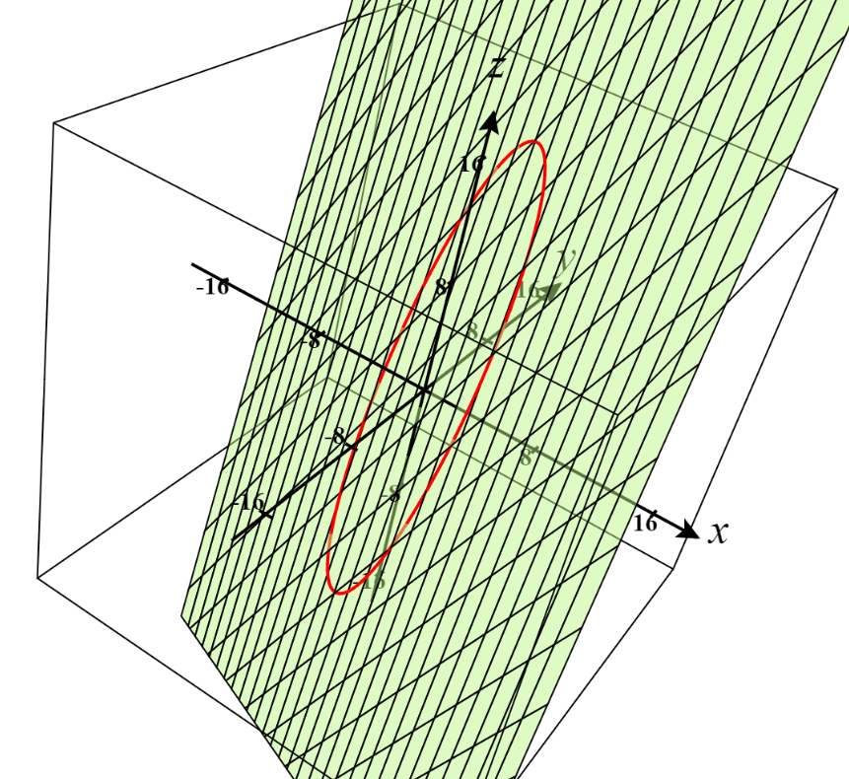
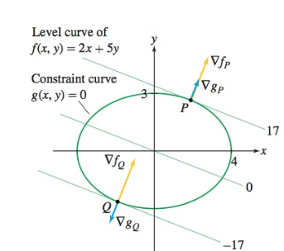
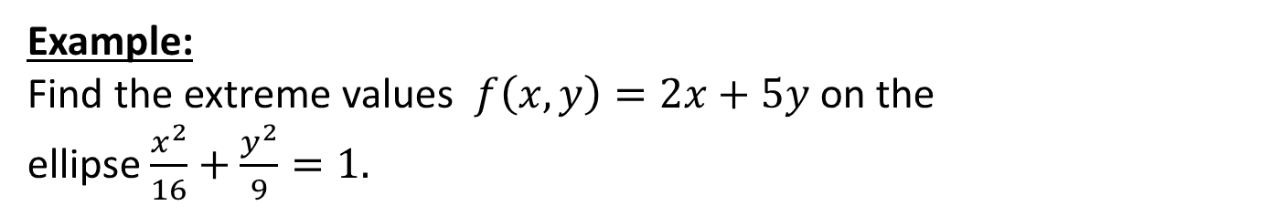
Lagrange Multipliers: Example
Example:
Find the extreme values $f\left(x,y\right)=2x+5y$ on the ellipse $\frac{x^{2}}{16}+\frac{y^{2}}{9}=1.$
Notes:
This is the 2 variable version. Notice the vectors are the gradients of the respective curves.

Slide 15
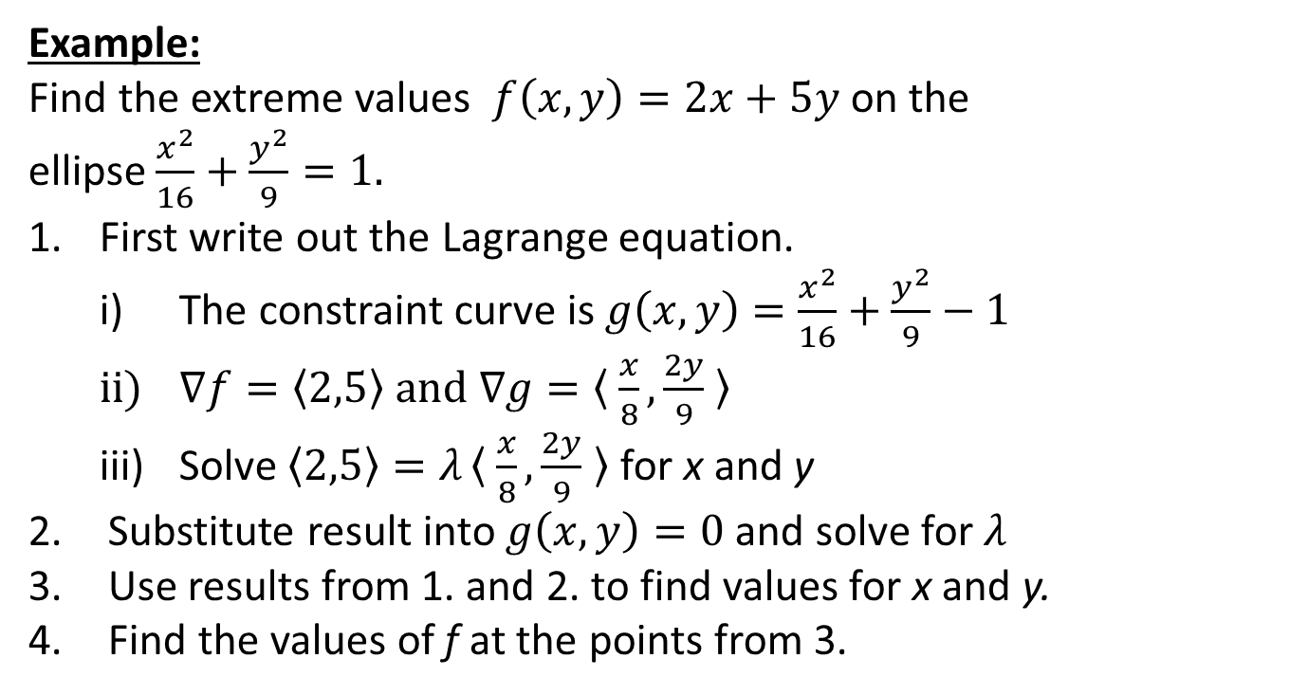
Lagrange Multipliers: Example
Example:
Find the extreme values $f\left(x,y\right)=2x+5y$ on the ellipse $\frac{x^{2}}{16}+\frac{y^{2}}{9}=1.$
First write out the Lagrange equation.
The constraint curve is $g\left(x,y\right)=\frac{x^{2}}{16}+\frac{y^{2}}{9}−1$
$∇f=〈2,5〉 and ∇g=〈 \frac{x}{8},\frac{2y}{9} 〉$
Solve $〈2,5〉=λ〈 \frac{x}{8},\frac{2y}{9} 〉$ for x and y
Substitute result into $g\left(x,y\right)=0$ and solve for $λ$
Use results from 1. and 2. to find values for x and y.
Find the values of f at the points from 3.
Notes:
Work out on board…solution x = +/- 32/17; y =+/- 45/17; lambda = 17/2

Slide 16
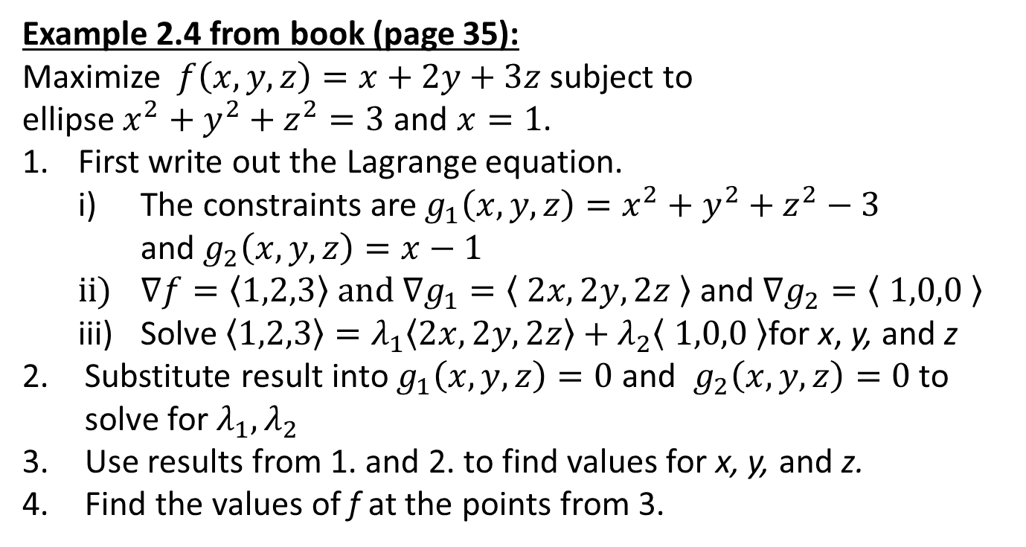
Lagrange Multipliers: Example (Slightly Harder)
Example 2.4 from book (page 35):
Maximize $f\left(x,y,z\right)=x+2y+3z$ subject to ellipse $x^{2}+y^{2}+z^{2}=3$ and $x=1$.
First write out the Lagrange equation.
The constraints are $g_{1}\left(x,y,z\right)=x^{2}+y^{2}+z^{2}−3$ and $g_{2}\left(x,y,z\right)=x−1$
$∇f=〈1,2,3〉 and ∇g_{1}=〈 2x,2y,2z 〉$ and $∇g_{2}=〈 1,0,0 〉$
Solve $〈1,2,3〉=λ_{1}〈2x,2y,2z〉+λ_{2}〈 1,0,0 〉$for x, y, and z
Substitute result into $g_{1}\left(x,y,z\right)=0$ and $g_{2}\left(x,y,z\right)=0$ to solve for $λ_{1},λ_{2}$
Use results from 1. and 2. to find values for x, y, and z.
Find the values of f at the points from 3.
Notes:
Work out on board…solution lambda1 = +/- sqrt(26)/4 lambda2 = 1-2lambda1;

Slide 17
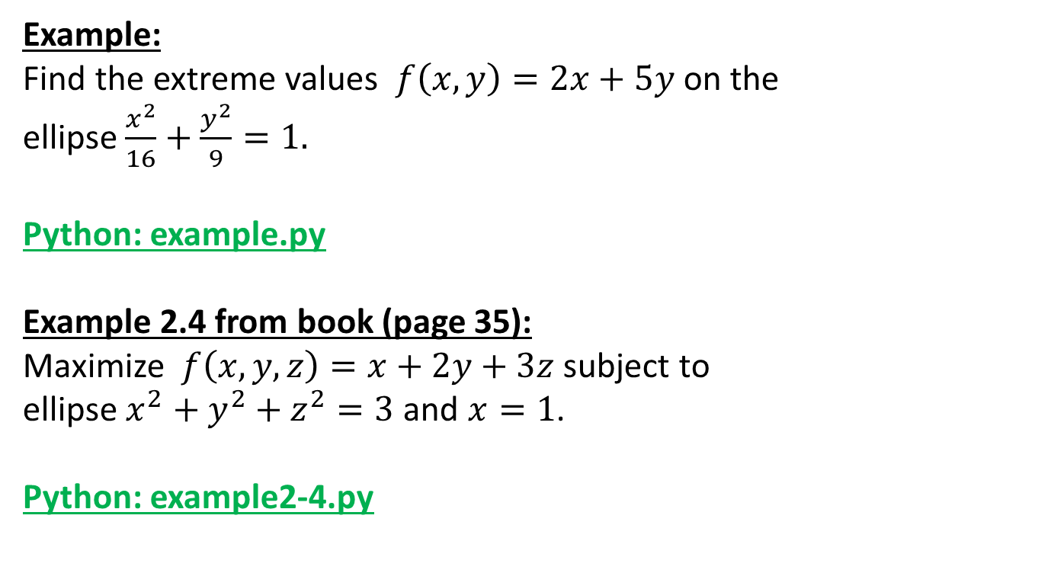
Lagrange Multipliers: Example (Using Python)
Example:
Find the extreme values $f\left(x,y\right)=2x+5y$ on the ellipse $\frac{x^{2}}{16}+\frac{y^{2}}{9}=1.$
Python: example.py
Example 2.4 from book (page 35):
Maximize $f\left(x,y,z\right)=x+2y+3z$ subject to ellipse $x^{2}+y^{2}+z^{2}=3$ and $x=1$.
Python: example2-4.py
Notes:
Python dictionaries; import; passing a function as a parameter

Slide 18
Back to Step 4: Solve the Problem
Maximize the function
$$f\left(x_{1},x_{2}\right)=−0.01x_{1}^{2}− 0.007x_{1}x_{2} + 144.0x_{1}− 0.01x_{2}^{2} + 174.0x_{2}− 400000$$
on the region $0≤x_{1}≤5000$
$0≤x_{2}≤8000$
$x_{1}+x_{2}≤10000$
feasible region – set of all possible solutions
Notes:
Based on the picture it appears the maximum is at the intersection of the purple contour and the region.
See python file section1-1pig.py

Slide 19
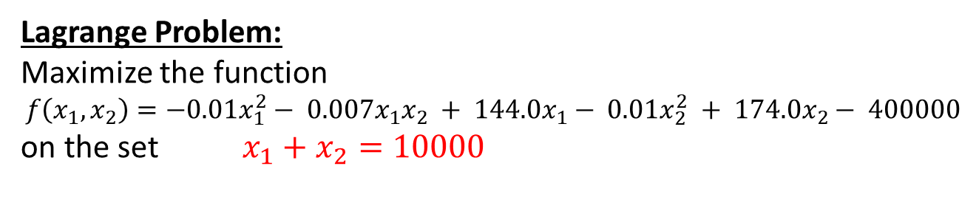
Step 4: Lagrange
Lagrange Problem:
Maximize the function
$$f\left(x_{1},x_{2}\right)=−0.01x_{1}^{2}− 0.007x_{1}x_{2} + 144.0x_{1}− 0.01x_{2}^{2} + 174.0x_{2}− 400000$$
on the set $x_{1}+x_{2}=10000$
Notes:
Based on the picture it appears the maximum is at the intersection of the purple contour and the region.
See python file section1-1pig.py

Slide 20
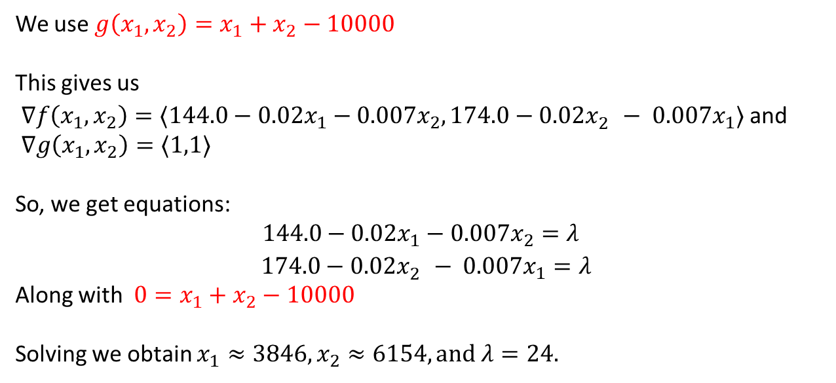
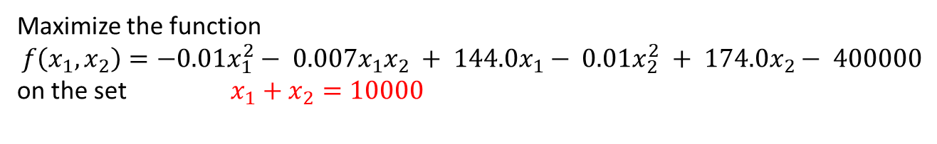
Step 4: Lagrange
Maximize the function
$$f\left(x_{1},x_{2}\right)=−0.01x_{1}^{2}− 0.007x_{1}x_{2} + 144.0x_{1}− 0.01x_{2}^{2} + 174.0x_{2}− 400000$$
on the set $x_{1}+x_{2}=10000$
We use ${g\left(x_{1},x_{2}\right)=x}_{1}+x_{2}−10000$
This gives us
$∇f\left(x_{1},x_{2}\right)=〈144.0−0.02x_{1}−0.007x_{2},174.0−0.02x_{2}^{}− 0.007x_{1}〉$ and
$∇g\left(x_{1},x_{2}\right)=〈1,1〉$
So, we get equations:
$$144.0−0.02x_{1}−0.007x_{2}=λ$$
$174.0−0.02x_{2}^{}− 0.007x_{1}=λ$
Along with ${0=x}_{1}+x_{2}−10000$
Solving we obtain $x_{1}≈3846, x_{2}≈6154, and λ=24.$

Slide 21
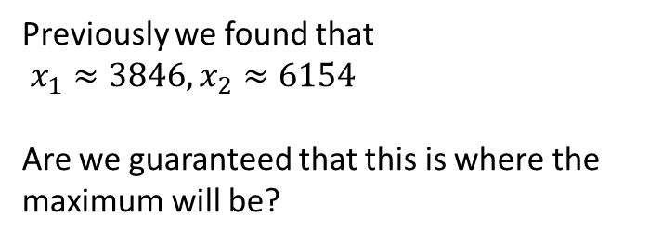
Step 4: Are we done yet?
Maximize the function
$$f\left(x_{1},x_{2}\right)=−0.01x_{1}^{2}− 0.007x_{1}x_{2} + 144.0x_{1}− 0.01x_{2}^{2} + 174.0x_{2}− 400000$$
on the region $0≤x_{1}≤5000$
$0≤x_{2}≤8000$
$x_{1}+x_{2}≤10000$
Previously we found that
$x_{1}≈3846, x_{2}≈6154$
Are we guaranteed that this is where the maximum will be?
Technically, Lagrange only tells us that this is the max over the line.

Slide 22

Step 4: A small argument
EVT tells use Maximum occurs at critical point or on boundary of this closed and bounded region.
From previous work (Section 2.1) the only critical point $x_{1}≈$4735.04 $x_{2}≈$7042.74 for this function is outside the region. So, maximum must occur on boundary.
Lagrange tells us that the maximum on the “slanted” line occurs at $x_{1}≈3846, x_{2}≈6154$
Technically there are 4 other parts of the boundary we need to check. There call have either ${x_{1} or x}_{2}$ constant, so they are easy to check.
These have one variable 0 and result in a negative maximum.
For the “right” side the max is at (5000, 5000) which is on the “slanted” line.
For the “top” side the max is at (2000,8000) which is on the “slanted” line.
Notes:
This

Slide 23
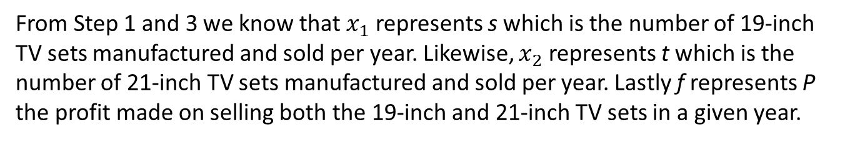
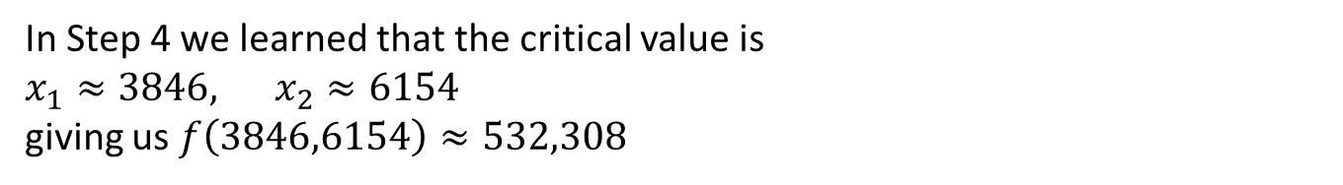
Step 5: Answer the question
Recall here we need to keep in mind.
Avoid technical jargon and mathematical symbols.
Anyone that can understand the original question should be able to understand your solution.
In Step 4 we learned that the critical value is
$x_{1}≈3846, x_{2}≈6154$
giving us $f\left(3846,6154\right)≈532,308$
From Step 1 and 3 we know that $x_{1}$ represents s which is the number of 19-inch TV sets manufactured and sold per year. Likewise, $x_{2}$ represents t which is the number of 21-inch TV sets manufactured and sold per year. Lastly f represents P the profit made on selling both the 19-inch and 21-inch TV sets in a given year.

Slide 24
Step 5: Answer the question
The company can maximize profits by manufacturing 3,856 of the 19-inch sets and 6,154 of the 21-inch sets for a total of 10,000 sets per yet.
This level of production uses all of the available excess production capacity.
The resource constraints on the on the availability of the TV circuit boards are not binding.
This venture will produce an estimated profit of $532,308. Based on the given information we should recommend the company proceed with the introduction of the product.

